Slide 1
Masterclass: A Technical Deep Dive on Liberty

Slide 2
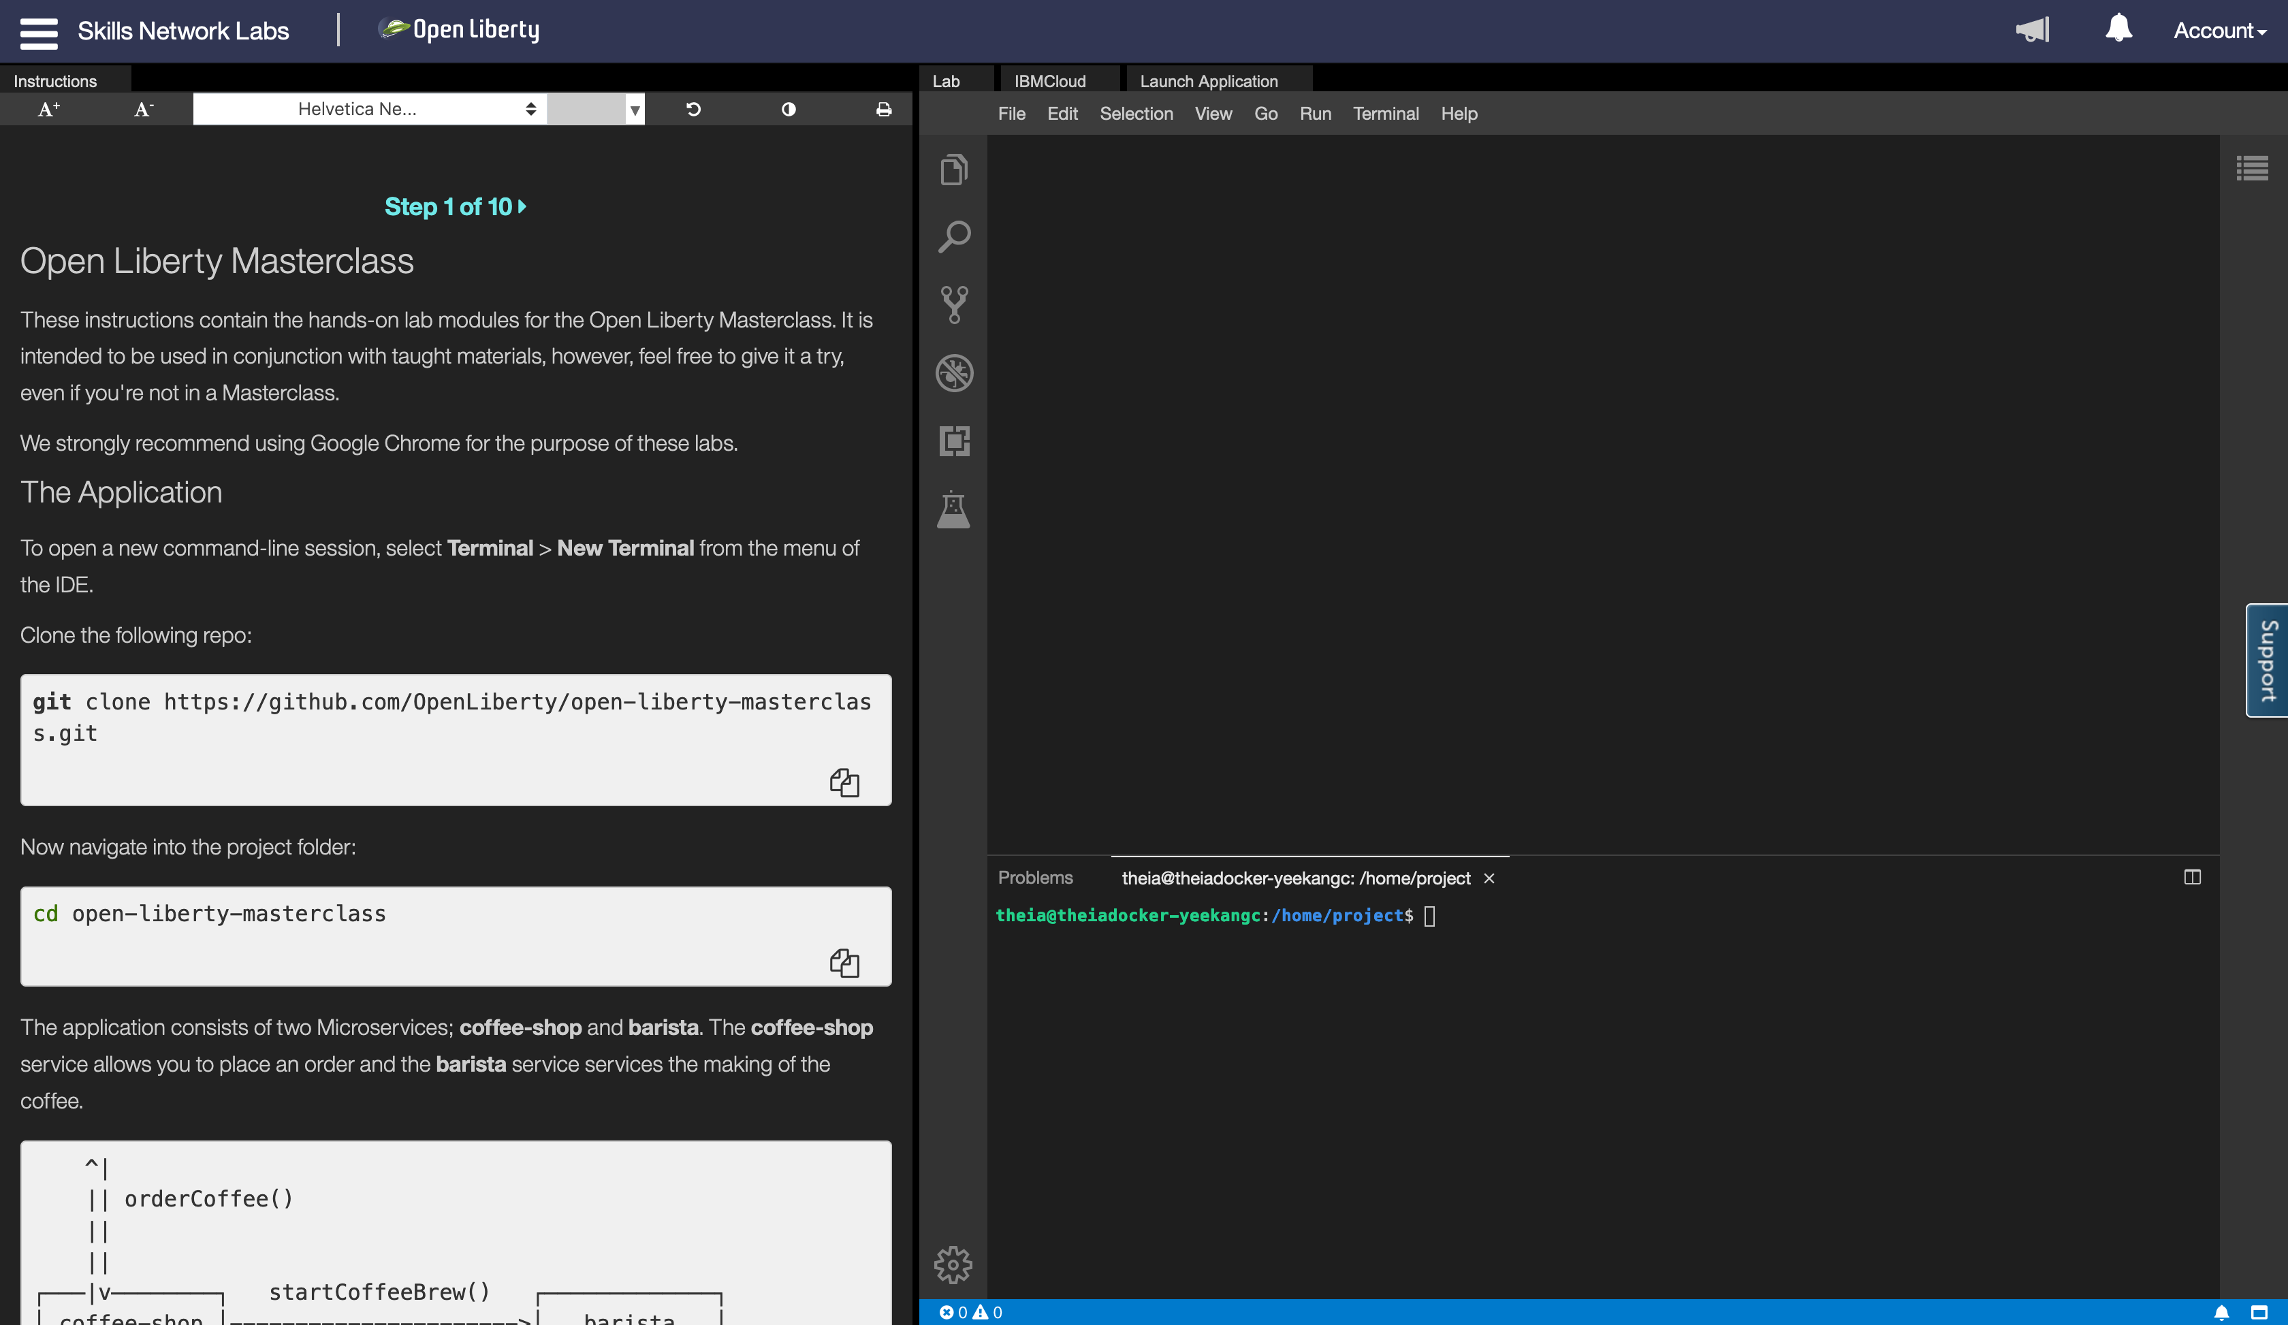
Ready to get your hands dirty?
Online exercises: https://ibm.biz/LibertyMasterclass
Hosted environment with an editor and a terminal that you can try online through your browser

Slide 3
Ready to get your hands dirty?
The Masterclass is open sourced at: https://github.com/OpenLiberty/open-liberty-masterclass
Follow the instructions in the ”Before you begin” section of the README.md to:
Install Pre-requisites
Prime Maven and Docker Caches

Slide 4
Mastersclass hands-on content
The Application
Module 1: Build
Module 2: Dev Mode
Module 3: Application APIs
Module 4: Server Configuration
Module 5: Externalizing Configuration
Module 6: Integration Testing
Module 7: Docker
Overriding Dev Server Configuration
Module 8: Testing in Containers
Module 9: Support Licensing
Conclusion

Slide 5
Background

Slide 6
6 reasons why Liberty
Just enough runtime
80% disk and 56% memory saving
Lightweight, highly-efficient runtime
CI/CD optimized operational experience
Simple true-to-production developer experience
Low operating cost
4x increased density over Tomcat & Spring Boot
Continuous delivery
Zero-effort security fixing & zero technical debt
Zero migration
100% v2v & fixpack migration saving
Kubernetes optimized
Self-tuned optimal perf, production-ready, kube-native
Developer experience
Container & kube-native experience, rapid inner loop

Slide 7
API Support
First shipped in WAS 8.5 in 2012
Servlet + JSP + JPA
Web Profile 6 in 2014
Java EE 7 in 2016 – first commercial product to certify
Java EE 8 in 2018 – first to certify
Jakarta EE 8 in 2019 – first to certify
Eclipse MicroProfile – first to deliver 1.0-1.4, 2.0-2.1, 3.0
Jakarta EE 9 – first vendor product to certify

Slide 8

openliberty.io
Launched September 2017

Slide 9
Liberty Architecture

Slide 10


Just Enough Application Server
You control which features are loaded into each server instance
Java EE
<feature>jaxrs-2.1</feature>
<feature>servlet-4.0</feature>
jaxrsClient-2.1
jsonp-1.1
jaxrs-2.1
servlet-4.0
appmgr
http-2.0
Kernel
Notes:
The server configuration allows you to control which features are loaded into a given server instance at a very fine-grained level, so you get exactly the function you want and no more.

Slide 11

Liberty Zero Migration
Zero config migration
Write once, run forever
Zero app migration
No behavior changes in existing features
New behaviors in new features
Choose your Java
Java 15, 11, 8
AdoptOpenJDK
IBM
OpenJDK
Oracle

Slide 12
Features

Slide 13
Periodic Table of Liberty (21.0.0.3)
 | batchSMFLogging-1.0 | zosLocalAdapters-1.0 | zosTransaction-1.0
 |  | zosRequestLogging-1.0 | zosWlm-1.0 | zosSecurity-1.0
collectiveController-1.0 | dynamicRouting-1.0 | healthManager-1.0 | scalingController-1.0
 | clusterMember-1.0 | healthAnalyzer-1.0 | scalingMember-1.0
cloudant-1.0 | heritageAPIs-1.0 | batchManagement-1.0
javaee-7.0 | sipServlet-1.1 | wsAtomicTransaction-1.2 |  | passwordUtilities-1.0
javaee-8.0 |  |  |  | wsSecurity-1.1
jakartaee-8.0 |  |  |  | wsSecuritySaml-1.0
bells-1.0 | microProfile-4.0 | adminCenter-1.0 | acmeCA-1.0 | audit-1.0
concurrent-1.0 | mpContextPropagation-1.0 | collectiveMember-1.0 | constrainedDelegation-1.0 | ldapRegistry-3.0
grpc-1.0 | mpGraphQL-1.0 | distributedMap-1.0 | federatedRepository-1.0 | oauth-2.0
javaMail-1.6 | mpReactiveMessaging-1.0 | eventLogging-1.0 | jwt-1.0 | openid-2.0
jaxb-2.2 | mpReactiveStreams-1.0 | logstashCollector-1.0 | jwtSso-1.0 | openidConnectClient-1.0
jdbc-4.3 | opentracing-1.3 | monitor-1.0 | sessionDatabase-1.0 | openidConnectServer-1.0
jpaContainer-2.2 | osgiConsole-1.0 | openapi-3.1 | webCache-1.0 | samlWeb-2.0
jsfContainer-2.3 | springBoot-2.0 | requestTiming-1.0 |  | scim-1.0
json-1.0 | webProfile-7.0 | usageMetering-1.0 |  | socialLogin-1.0
jsonbContainer-1.0 | webProfile-8.0 | restConnector-2.0 |  | spnego-1.0
jsonpContainer-1.1 |  | sessionCache-1.0 |  | transportSecurity-1.0
zOS
Security
ND
Operations
Base
Core
Open Liberty
New in 4Q20
New in 3Q20
New in 2Q20
New in 1Q21
APIs
Notes:
Stabilized features are not shown. See https://www.ibm.com/support/knowledgecenter/en/SSEQTP_liberty/com.ibm.websphere.wlp.doc/ae/rwlp_stabfeat.html
Where there are multiple features of same version most recent is shown.

Slide 14
Build
Module 1

Slide 15
Support for Maven and Gradle
Manage full server and application lifecycle through the two most popular build technologies.
Maven
liberty-maven-plugin
liberty-archetype-*
Docs & Source: https://github.com/OpenLiberty/ci.maven
Gradle
liberty-gradle-plugin
Docs & Source: https://github.com/OpenLiberty/ci.gradle
All the artefacts you need in Maven Central
https://search.maven.org/search?q=io.openliberty
https://search.maven.org/search?q=com.ibm.websphere

Slide 16
Dev Mode
Module 2

Slide 17

dev mode
Boosts developer productivity
Immediate feedback for code and config changes
No re-build necessary
Hot deployment, testing and debugging
In containers for near-production testing
mvn liberty:dev
mvn liberty:devc
gradle libertyDev
gradle libertyDevc

Slide 18
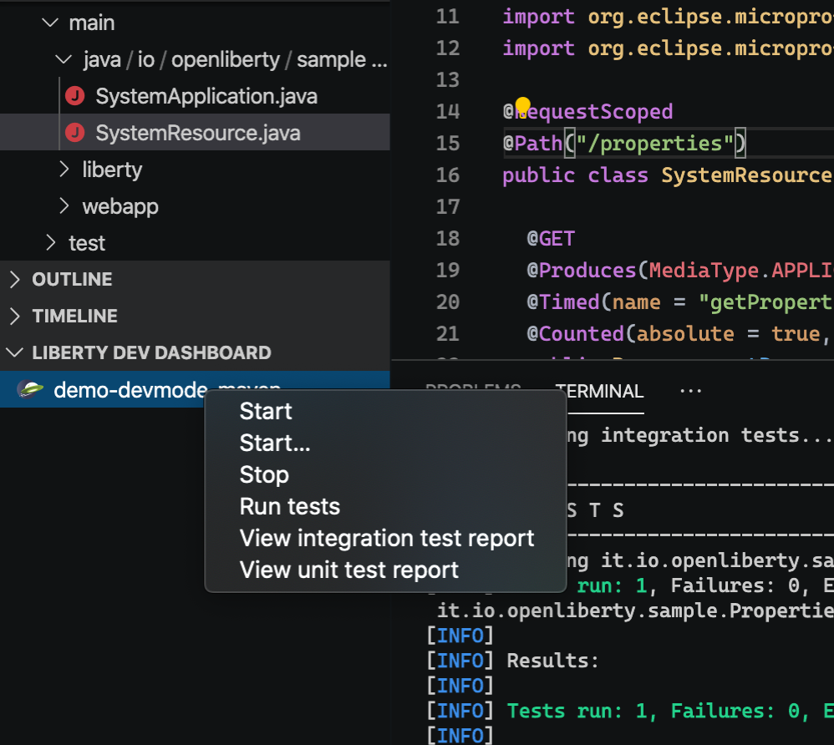
Tools
Open Liberty Tools for VS Code, IntelliJ & Eclipse
Start/Stop server
Run tests
View test reports
MicroProfile Starter
Create a new custom Microservice project within the IDE
MicroProfile REST Client Generator
Generate a REST client based on an OpenAPI definition

Slide 19












Developer experience
IDEs
Repositories
Build
Dev Mode
APIs
Testing

Slide 20
Application APIs
Module 2

Slide 21
Java EE 7
appClientSupport-1.0 | ejbPersistentTimer-3.2 | jaspic-1.1 | managedBeans-1.0
batch-1.0 | ejbRemote-3.2 | jaxb-2.2 | mdb-3.2
concurrent-1.0 | j2eeManagement-1.1 | jaxws-2.2 | wasJmsClient-2.0
ejb-3.2 | javaMail-1.5 | jca-1.7 | webProfile-7.0
ejbHome-3.2 | jacc-1.5 | jms-2.0 | wmqJmsClient-2.0
appSecurity-2.0 | jaxrsClient-2.0 | jsp-2.3
beanValidation-1.1 | jdbc-4.2 | managedBeans-1.0
cdi-1.2 | jndi-1.0 | servlet-3.1
ejbLite-3.2 | jpa-2.1 | ssl-1.0
el-3.0 | jsonp-1.0 | websocket-1.1
jaxrs-2.0 | jsf-2.2

Slide 22
Jakarta EE or Java EE 8
appClientSupport-1.0 | ejbHome-3.2 | jacc-1.5 | managedBeans-1.0
appSecurityClient-1.0 | ejbPersistentTimer-3.2 | jaxb-2.2 | mdb-3.2
batch-1.0 | ejbRemote-3.2 | jaxws-2.2 | wasJmsClient-2.0
concurrent-1.0 | j2eeManagement-1.1 | jca-1.7 | webProfile-8.0
ejb-3.2 | javaMail-1.6 | jms-2.0 | wmqJmsClient-2.0
appSecurity-3.0 | jaxrs-2.1 | jsonp-1.1 | websocket-1.1
beanValidation-2.0 | jaxrsClient-2.1 | jsf-2.3
cdi-2.0 | jdbc-4.2 | jsp-2.3
ejbLite-3.2 | jndi-1.0 | managedBeans-1.0
el-3.0 | jpa-2.2 | servlet-4.0
jaspic-1.1 | jsonb-1.0 | ssl-1.0

Slide 23
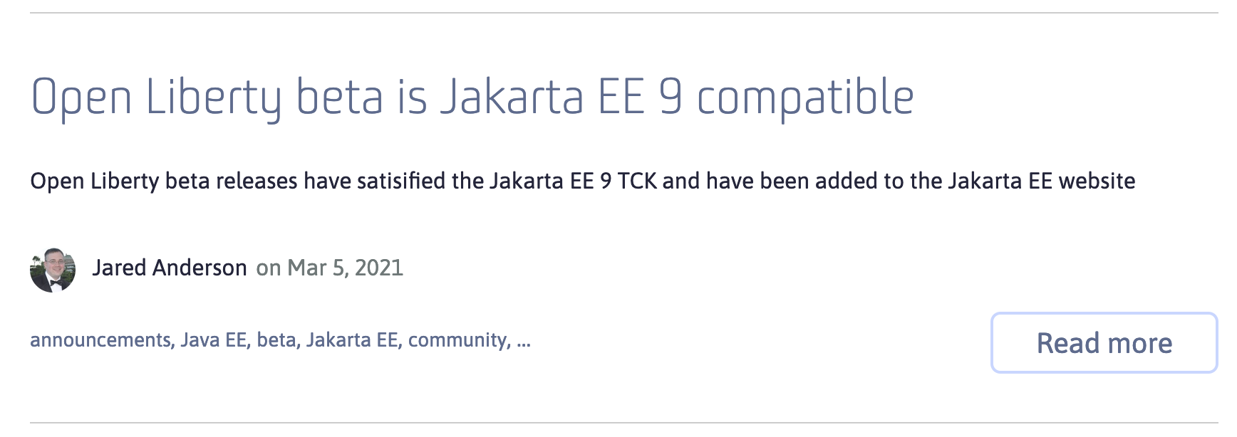
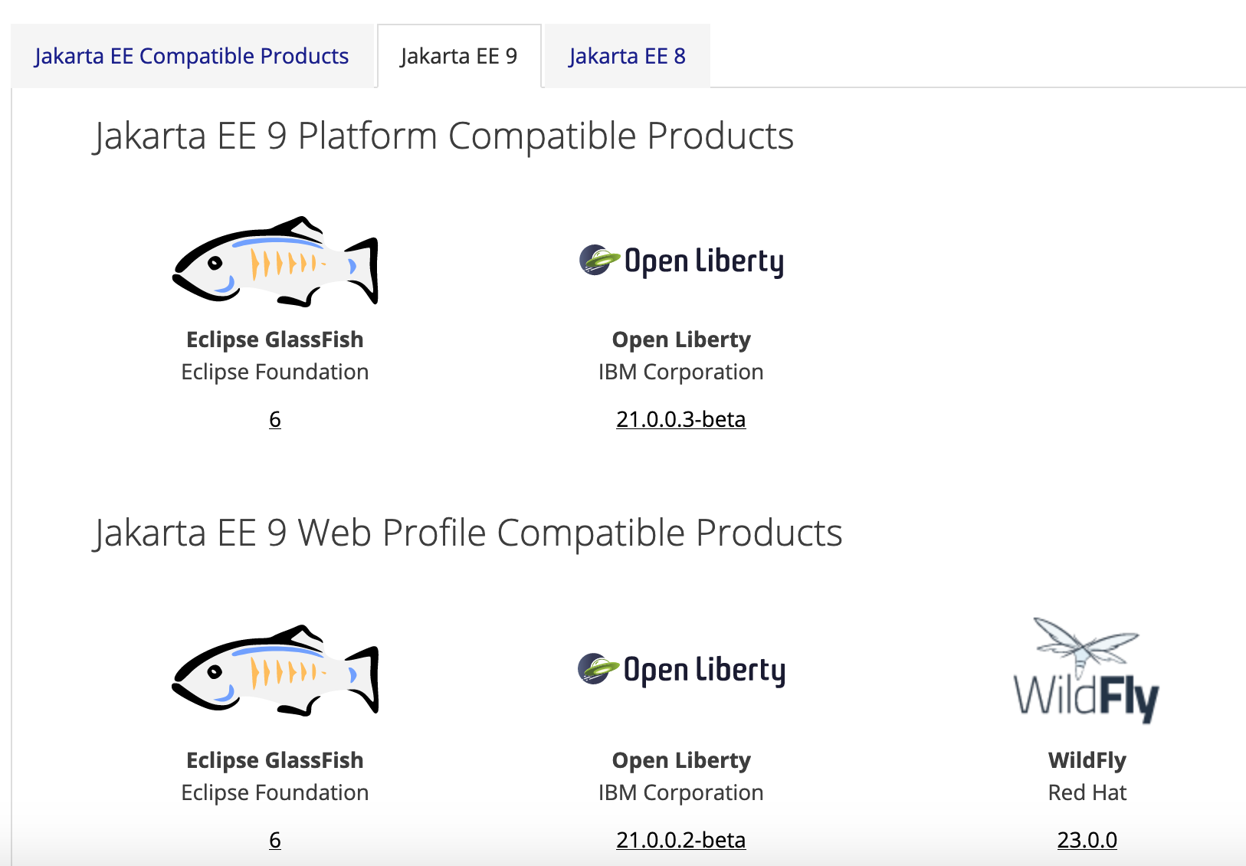

javax.* -> jakarta.*
https://openliberty.io/blog/2021/03/05/jakarta-ee-9-compatibility.html
https://jakarta.ee/compatibility/#tab-9
Notes:
Recently, we announced our full compatibility for Jakarta EE 9, for both the whole platform and web profile.
Liberty was the first implementation to declare full compatibility outside of the reference implementation.
You can try all the features for Jakarta EE 9 in the 21.0.0.2 beta release of Open Liberty.

Slide 24

Open cloud-native Java APIs
https://microprofile.io/
Observe
Open Telemetry
Open Tracing
Health Check
Metrics
Integrate
GraphQL
Reactive Messaging
OpenAPI
Fault Tolerance
JWT
Core
Config
JAX-RS
CDI
Rest Client
JSON-B
JSON-P
Notes:
Eclipse MicroProfile is a set of cloud native capabilities, implemented by our Java runtimes, that provide standard applications annotations implementations for applications to use in containers – building on a core of familiar Java EE technologies. LRA is one of the newest MicroProfile specificactions, derived from WS-BA, to provide a simple compensating transaction for Java microservices.
The blue specs are part of the MicroProfile 3.3 release. ReactiveMessaging and LRA are standalone specs.
The LRA model provides a good balance between a loosely coupled transaction model that preserves independence of application lifecycle of each microservce and application simplicity over maintaining data consistency in the presence of failure. Simple Java annotations are used to register completion and compensation tasks while the platfrom takes care of ensuring these get invoked appropriately, across any form of system failure.

Slide 25
MicroProfile
Builds on Java EE
By the Java EE community
Open Source at Eclipse
Multiple Implementations
@Path(“/”)
public class RestEE {
@GET @Counter @Traced
public String hello() {
return "Hello MicroProfile!!";
}
}
Notes:
@Bulkhead allows you to specify number of concurrent requests. waitingTaskQueue allows requests to be queued rather than failing. To use waitingTaskQueue, you also need to specify @Asynchronous to prevent immediate rejection.

Slide 26
Server Configuration
Module 4

Slide 27
Simple Config
<server>
<featureManager>
<feature>jaxrs-2.1</feature>
</featureManager>
<webApplication location=“myweb.war” contextRoot=“/” />
<applicationManager autoExpand="true"/>
</server>
server.xml
-Xmx1g
-Dsystem.prop=value
WLP_OUTPUT_DIR=/usr/wlp-out/
jvm.options
server.env

Slide 28
Composing Config
<server>
<httpEndpoint id=“defaultHttpEndpoint” host=“${host}” httpPort=“${http}” httpsPort=“${https}”/> </server>
configDropins/defaults/common-http.xml
<server>
<include location="https://myHost/ports.xml”/>
<variable name=“host” value=“${my.host}”/>
<variable name=“http” value=“${my.host.http}”/>
<variable name=“https” value=“${my.host.https}”/> </server>
configDropins/overrides/ports.xml
Notes:
Mention you can check in config.

Slide 29
Externalizing Configuration
Module 5

Slide 30
Variable Resolution
Liberty variable resolution happens top to bottom
server variables
Java system properties
bootstrap properties
env vars
Notes:
30
Describe background information that will be useful to help understand how this feature will be used or integrated into the product. Use this slide to cover existing concepts and the Key Concepts chart to cover new material that will need documentation.

Slide 31
Externalizing Config
<server>
<httpEndpoint id=“defaultHttpEndpoint” host=“*” httpPort=“${env.SERVER_HTTP_PORT}” httpsPort=“${env.SERVER_HTTPS_PORT}”/> </server>
configDropins/defaults/common-http.xml
Notes:
Mention you can check in config.

Slide 32
MicroProfile
Inject Configuration
Sourced from
Properties file
Environment
Java system properties
@Path(“/”)
public class RestEE {
@Inject @ConfigProperty(“name”)
private String name;
@GET @Counter @Traced
public String hello() {
return "Hello " + name;
}
}
Notes:
@Bulkhead allows you to specify number of concurrent requests. waitingTaskQueue allows requests to be queued rather than failing. To use waitingTaskQueue, you also need to specify @Asynchronous to prevent immediate rejection.

Slide 33
Testing
Module 6

Slide 34
Testing
Use maven-surefire-plugin to run unit test
Use CDI dependency injection to make your code easy to mock & unit test
Use maven-failsafe-plugin to run integration test
Use Liberty Arquillian integration to run tests on a Liberty server
Use MicroShed Testing for system testing in Containers (Module 8)

Slide 35
Docker
Module 7

Slide 36


Liberty in Containers
IBM Cloud Kubernetes Service
app and config
Azure Kubernetes Service
Hosted Cloud
+
Google Kubernetes Engine
Amazon Elastic Kubernetes Service
liberty and java
Jelastic
=
+
os config
portable container
Red Hat Open Shift Container Platform
+
Private Cloud
Pivotal Kubernetes Service
Pivotal Cloud Foundry
docker
FROM open-liberty
ADD myapp.war /config/dropins/myapp.war
Notes:
In any environment – bare metal, virtualised, cloud, containers – WAS is supported on a wide variety of operating systems and you can roll your own cloud using scripting, dev/ops tools, or a technology of your choice
* In the IBM Bluemix cloud, Liberty runs on all three compute options:
in the original Bluemix environment: CloudFoundry PaaS or ‘Instant Runtimes’, liberty provides the Java runtime
* in the IBM Container Service, liberty servers can be wrapped in portable Docker containers and managed by the container service
WAS can be installed and run in VMs provided by the OpenStack VM service which is currently in Beta
Just available this month is ‘IBM Application Server on Cloud in Bluemix’ which will let users rent WAS instances in a shared environment
more info on Bluemix compute options: https://developer.ibm.com/bluemix/2015/08/05/bluemix-instant-runtimes-containers-or-virtual-machines/
* Liberty can be easily installed and configured in a private IaaS environment. Pure Application patterns for WebSphere make the deployment of servers more efficient.
* Public IaaS options are also available:
on IBM’s SoftLayer you can install and configure Liberty directly onto rented VMs, or get pre-configured instances from the ‘IBM Application Server on Cloud’ service, this time in a dedicated environment. You can also rent WAS instances on Microsoft Azure and Amazon Web Services
If you choose a non-IBM PaaS you can also run Liberty there. There is an open-source buildpack for CloudFoundry and Heroku, which forms the core of the Bluemix buildpack so is highly functional and very well tested. That buildpack is also wrapped to provide the liberty cartridge for use in the OpenShift PaaS.
So we provide a wide choice of cloud environments for running WAS, and the bottom line is that WAS Liberty is technically small and simple enough to run in any environment, and we want to support you in running Liberty in whatever environment you choose.

Slide 37

Making the most of Docker
Application
Application
App Server
JVM
JVM
O/S
O/S
thin war
fat jar
Notes:
Alasdair
Talk about exploiting Docker and Docker layers.
FAT jars are not your friend.
Docker and Kube are your friend and really the future for deployment

Slide 38
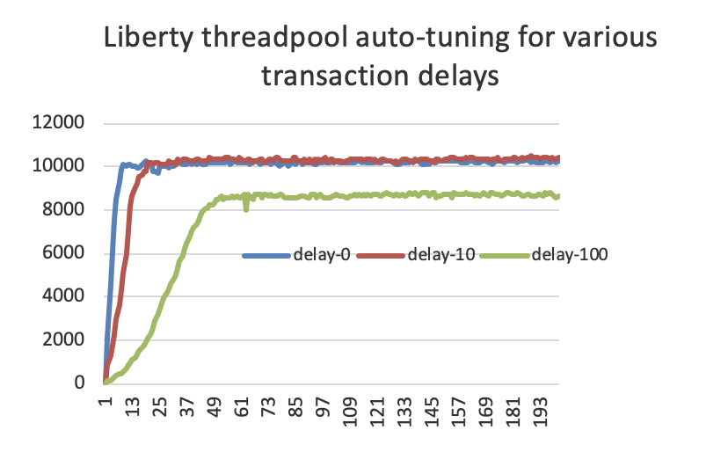
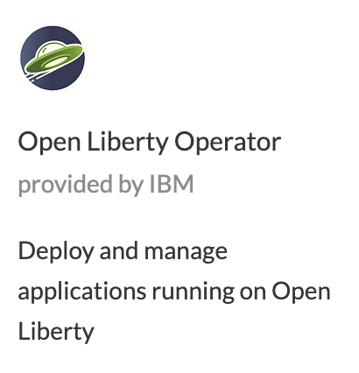


Kubernetes optimized
Deliver faster without costly tuning exercises
Get optimal performance even as the environment changes
Simple Operator-based deploy and day-2 operations experience
Supported production-ready images
APIs for Kubernetes integration
Container-based usage tracking

Slide 39
Testing in Containers
Module 8

Slide 40
MicroShed Testing
@MicroShedTest
public class MyTest {
// Search for Dockerfile.
// Start app in Container.
// Wait for Container before running tests.
@Container
public static MicroProfileApplication app
= new MicroProfileApplication()
.withAppContextRoot("/myservice");
// Inject JAX-RS REST Client
@Inject
public static MyService mySvc;
// A test method like any other
@Test
public void testMyService() {
...
}
}
Integration tests that are easy to setup, write, and run
Test your apps the same way they run in production...in Containers
Can run multiple containers on same network (e.g. test DB integration)
https://microshed.github.io/

Slide 41
Support Licensing
Module 9

Slide 42



How to get Support
WebSphere
WebSphere Hybrid Edition
IBM Integrated Application Runtimes
Java:
WebSphere
Liberty
MicroProfile
Jakarta EE
OpenJ9
z/OS
ND
Base
Core
Cloud Foundry Migration Runtime
Transformation Advisor
Mono2Micro
Red Hat OpenShift

Slide 43
Wrap-up

Slide 44
Mastersclass hands-on content
Open Liberty Masterclass
Table of Contents
Before you begin
Install Pre-requisites
Prime Maven and Docker Caches
The Application
Module 1: Build
Module 2: Dev Mode
Module 3: Application APIs
Module 4: Server Configuration
Module 5: Externalizing Configuration
Module 6: Integration Testing
Module 7: Docker
Overriding Dev Server Configuration
Module 8: Support Licensing
Conclusion

Slide 45
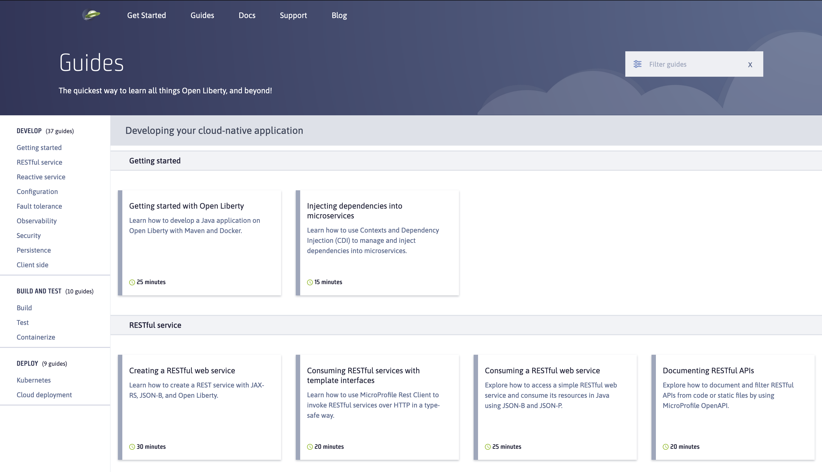

Slide 46
Thank You

